Slide 1

UNIVERSITY PROJECT – 2 HYRE – Higher You Reach Every time Group - 08

Slide 2
A PROJECT BY
Mr. Prajwal M S – 20171CSE0519
Mr. Prajwal P – 20171CSE0520
Mr. Pramukh N S – 20171CSE0524
Ms. Priyanka A – 20171CSE0536
Ms. Rachna Shah – 20171CSE0551
Under the guidance of
Mr. James Mathew P

Slide 3
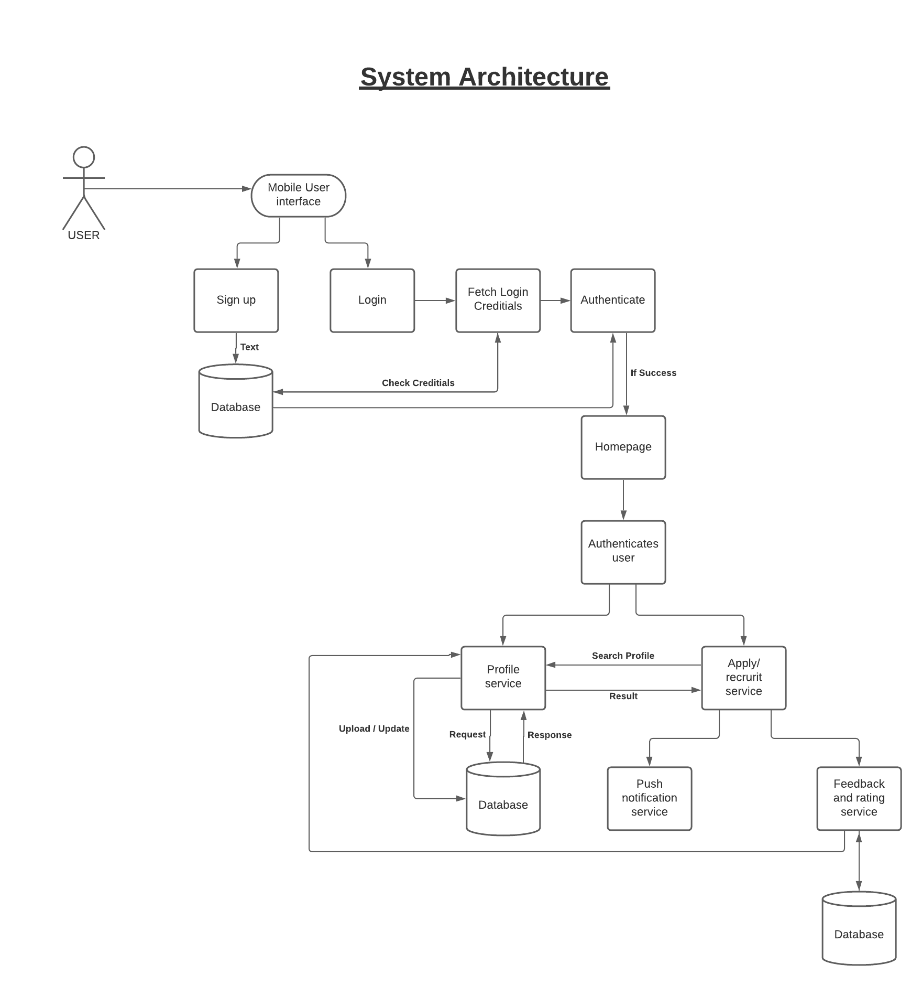
HYRE System Architecture

Slide 4
Modules
Login – It is a set of credentials used to authenticate a user.
Sign up – It is a phrase where we define our credentials to set up an online account.
Homepage - It is the first page of the interface whenever user login with their credentials.
Database – It is a collection of user’s data.

Slide 5
Modules
Profile service – A section where it represents the digital representation of one’s identity.
New Project - This allows the company to add new projects.
Push Notification service – User’s get notified through notification when a user apply or recruit.
Feedback and Rating service – This service is provided by Project Owner and it is a representation of freelancer work.

Slide 6
Firebase
Firebase is a real-time cloud hosted database.
Data is stored as Json and is synchronized in real-time to every connected client.
Secure access to the database directly from client-side code.
Can be accessed directly from mobile or web browser.
Remains responsive even in offline. Once connectivity is re-established, client device receives any changes it missed.

Slide 7
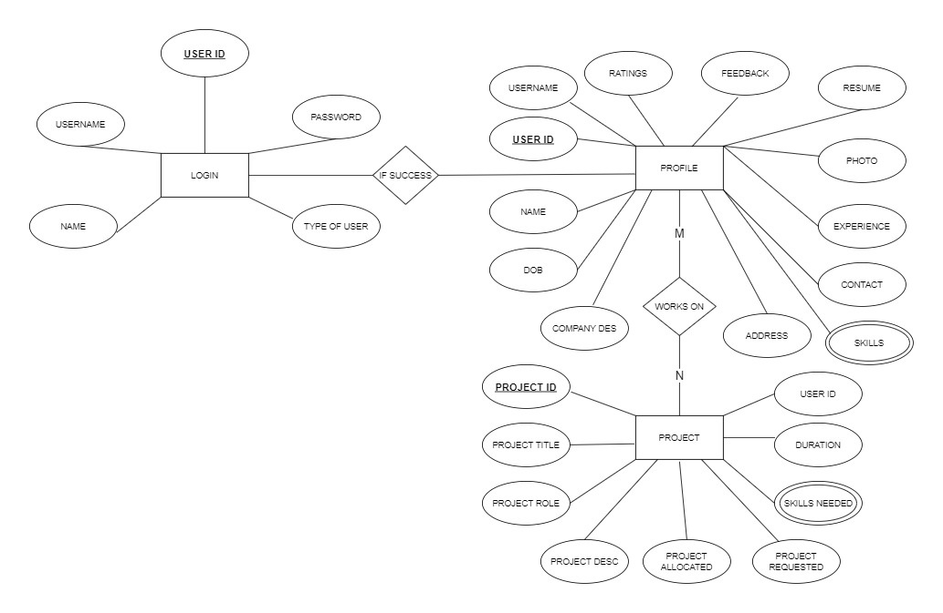
HYRE Database ER Diagram

Slide 8
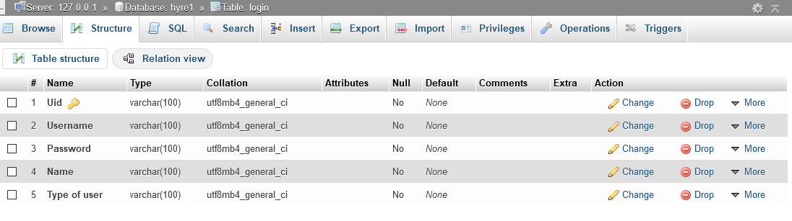
Table Schema – Login Table

Slide 9
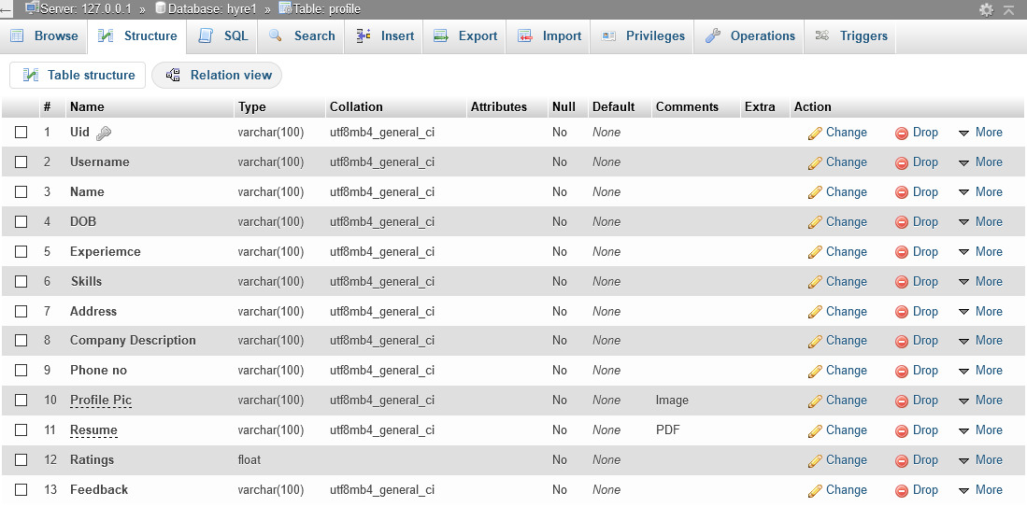
Table Schema – Profile Table

Slide 10
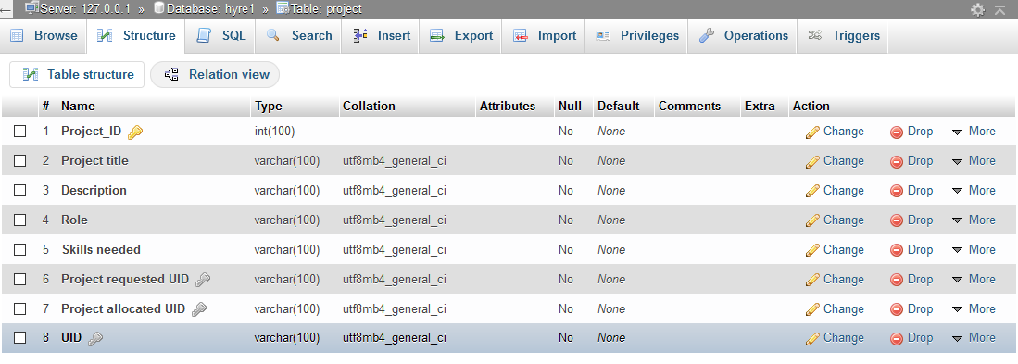
Table Schema – Project Table

Slide 11
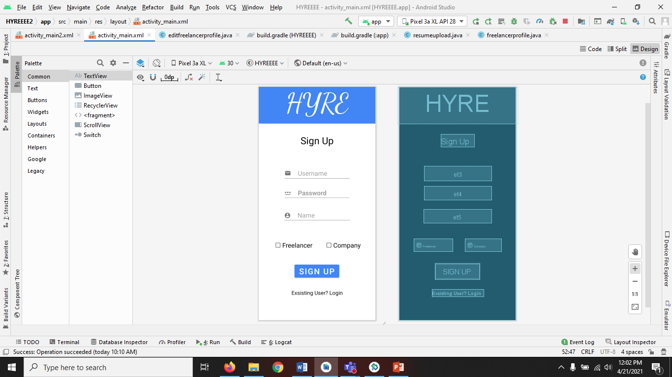
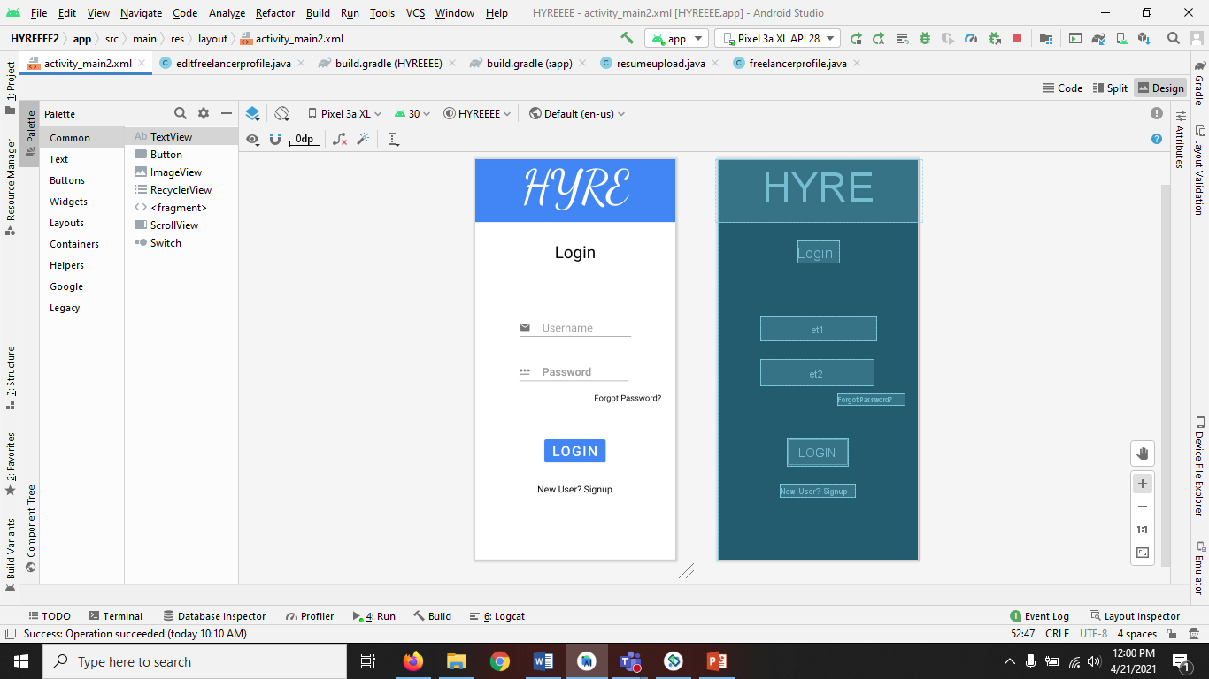
User Interface Design
Sign up Page
Login Page

Slide 12
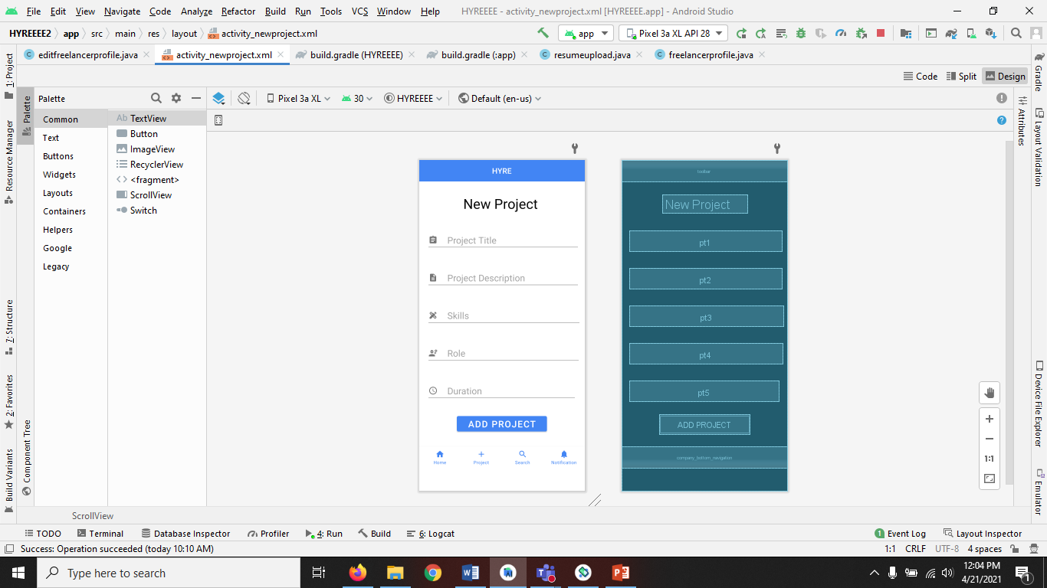
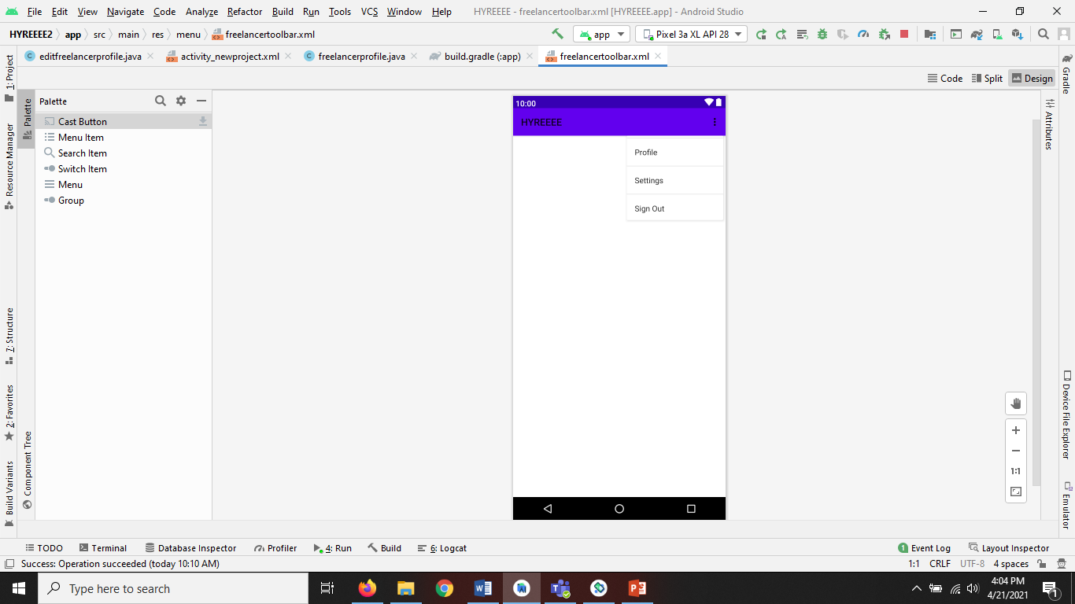
User Interface Design
New Project Page
Menu

Slide 13
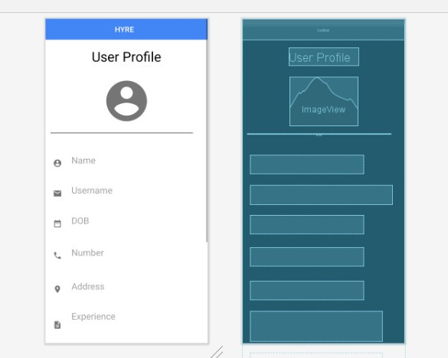
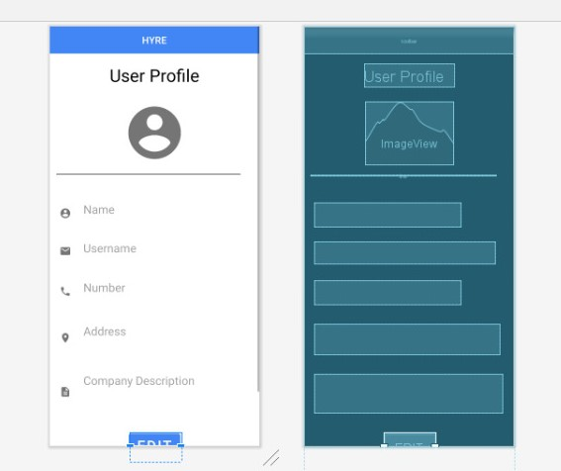
User Interface Design
Freelancer Profile Page
Company Profile Page

Slide 14
Progress So far…
100%
100%
60%
60%
0%
BRAINSTORMING
WIREFRAME
DEVELOPMENT
WORKING
DEPLOYMENT

Slide 15


